Slide 1
Planning Boards: An Introduction to the Basics
September 2020
Presented by WGM Group
Notes:
If you are a planning board member, thank you for volunteering your time for the important work you do in your community.
This webinar is based on the Montana Planning Board Members Handbook, updated in 2020. It is intended for new planning board members as well as those who may have more experience. The Handbook has more information and is available from the Montana Department of Commerce, Community Technical Assistance Program.
In this webinar we will cover:
The purpose of a Planning Board
Planning Basics and the Growth Policy
Planning Board’s Role in Subdivision Review
Conducting Meetings and Hearings
Planning Board Organization

Slide 2
PLANNING BOARD BASICS
What does the Planning Board do??
What is a Planning Board?
Advisory board:
Citizens
Appointed by the Governing Body
Advise on land use matters
Growth Policies
Subdivision
County-Initiated Zoning
Urban Renewal Plans
Conservation Easements
Develop public infrastructure plans
Develop subdivision regulations
Advise on lakeshore regulations and permits
Advise on other plans
Notes:
What is a Planning Board?
A planning board is a group of citizens who advise on planning, land use, and community development for towns, cities, and counties. The governing bodies of the local jurisdiction appoint them. The governing body of a county is the board of county commissioners and the governing body of a city or town is the city council or city commission.
What does the Planning Board do?
Planning boards advise the governing bodies on land use matters.
The two lists on the bottom right show those functions authorized or required in Montana state statute. Planning boards have a role in growth policies, subdivision, county-initiated zoning, urban renewal plans, conservation easements, and lakeshore regulations. In addition, they can propose subdivision regulations, and regulations and plans for infrastructure. They can also advise on other plans.
Although there are several land use matters that involve a planning board, some of the requirements apply only in counties and some apply only in cities.
In most Montana communities, planning boards spend more time on subdivision review than any other function. Developing and implementing growth policies is typically next in terms of work effort.

Slide 3
PLANNING BOARD ORGANIZATION
Jurisdiction - Type
Bylaws
Working Relations
Statutory requirements:
Membership & qualifications
…..
County Board
City Board
City-County Board
Consolidated Board
Joint Board
Governs board operation
Statutory duty to develop “
Governing Body
Planning Board
Staff
Notes:
In Montana, each planning board has a legally defined area for which it is responsible, the planning board’s “jurisdictional area.” The jurisdictional area can be a city, a county, or a combination of cities, or cities and counties. The number of planning board members and what jurisdictions they represent varies by what is included in the planning board’s jurisdictional area.
State statute instructs planning boards to develop “regulations” for planning board affairs. Planning boards adopt and operate under bylaws to fulfill this statutory duty.
The planning board can make recommendations on land use matters, but the governing body makes the final decisions. The governing body also appoints staff to assist with planning board activities.
Staff typically administer local regulations and prepare detailed written reports for planning board review on proposed subdivisions, growth policies, and other land use matters.

Slide 4
PLANNING BOARD FUNDAMENTALS
1. Act in the public Interest
Public’s right to know and participate
Decisions in the interest of the community as a whole
Legally defensible decisions – “Findings of Fact”
Acting in public interest
2. Provide Objective Decisions
Helps ensure objective decision-making
Understand purpose of plans and regulations
3. Understand Plans and Regulations
4. Stay Current with State Statute
Requirements for Planning Board, Subdivision, etc.
Can change every two years
CONFIGURATIONS
5. Involve the Public
Communicate value of planning
Encourage broad participation - diverse perspectives
Listen and consider public comment before decisions
Notes:
These fundamentals can guide how you act in any task you take on as a board member.
1. Act in the Public Interest
Planning board members must act and make decisions in the “public interest.” The public interest represents the benefits to society rather than to a certain group or an individual. For the planning board, the society is the community that you serve in your jurisdictional area.
2. Provide Objective Decisions
Objective, reasonable decision-making based on facts is fundamental to sound and legally defensible decisions. Every decision on a land use application reviewed by the planning board should have a written record, called “Findings of Fact.”
3. Understand Plans and Regulations
Read and be familiar with the local growth policy, local subdivision regulations, and any other regulations and plans the planning board deals with on a regular basis. Doing so will help to ensure objective decision making.
4. Work to Update Local Regulations to Conform to State Statute
Much of what you review as a planning board member is explicitly required by Montana statute. Montana land use statutes have been changed in nearly every legislative session for the past 20 years. If local regulations, including subdivision regulations, are not updated to conform to state statute, it can result in confusion and potential legal issues.
5. Involve the Public and Build Awareness
Encouraging public involvement, communicating the value of planning, and consensus building are important for planning board members. Planning board members learn what is important to everyone in the community by listening to citizens’ concerns, especially those concerns of differing views.

Slide 5
WHY PLAN? 10 Reasons
Drives constructive change in a long-range context
Communities that don’t plan get left behind
Builds momentum for priority projects
Ensures initiatives are not redundant or going in different directions
More cost effective than reacting to problems
Provides predictability
Easier for private sector to assess costs and benefits of development
Provides continuity through political cycles
Improves ability to compete for economic activity
Helps conserve areas important for public and environment
Notes:
1. Planning drives constructive change in a long-range context
2. Communities that don’t plan get left behind
3. Planning builds momentum for priority projects
4. Planning ensures initiatives are not redundant or going in different directions
5. Planning is more cost effective than reacting to problems
6. Planning provides predictability
7. Planning makes it easier for private sector to assess costs and benefits of development
8. Planning provides continuity through political cycles
9. Planning improves ability to compete for economic activity
10. Planning helps conserve areas important for public and environment
In addition, planning makes it easier to secure project funding.
Government agencies and private-public partners want to see how a proposed project fits within a bigger picture of long-range planning. Some will not fund without that information.

Slide 6
Planning Board Role in Adopting GROWTH POLICIES
Governing Body
Staff
Growth Policy Contents
Existing and Future Trends
Goals and Objectives
Implementation Strategies & Schedule
Subdivision Review Criteria
Subdivision Hearing Process
Public Infrastructure Strategy
Provisions for Updates
And more…..
Planning Board
Public
makibestphoto - stock.adobe.com
Notes:
In Montana, a growth policy is the plan that describes the community’s long-term vision and the general steps needed to achieve the vision. The term growth policy is equally applicable to Montana communities that are experiencing dramatic population increases and those that have static or declining populations. All communities can benefit from establishing a vision for their future.
Montana statute requires planning boards to develop growth policies, hold a public hearing, and make a recommendation to the governing body. It doesn’t require planning boards to actually write the plan. Staff who are familiar with statutory requirements typically write the document with guidance from the planning board.
Montana statute requires the following contents in a growth policy:
• Existing and future trends for several topics including land uses, population, housing, economics, local services, and natural resources
• Goals and objectives
• Implementation – strategies and schedule
• Subdivision Review Criteria
• Subdivision Hearing Process
• Public infrastructure strategy
• Provisions for updates
• And more items that may be required under certain circumstances or that are optional add-ons
Planning board members’ roles on a growth policy generally include:
• Guiding development of the growth policy overall,
• Understanding why a growth policy is important and being able to communicate that to others
• Reviewing draft documents and other growth policy materials
• Discussing drafts and other growth policy items with staff or consultants, as part of scheduled planning board meetings
• Encouraging opportunities for sharing information with the public and obtaining comments to help shape the growth policy before the required public hearing
• Holding a public hearing, and considering comments prior to making a recommendation to the governing body (This last item is a requirement of Montana statute)

Slide 7
Planning Board Role in Implementing GROWTH POLICIES
Monitor Progress
Review Regulations and Applications
Subdivision regulations
Review Other Plans
Growth Policy Amendments (e.g., downtown master plans)
Capital Improvement Plans
Municipal zoning
Subdivision applications – review criteria and public hearings
Conservation easements
Annexation Policies – Extension of Services
Urban Renewal District Plans
Other plans – transportation, housing, trails, etc.
Advocate for moving forward
Provide annual progress reports
Be proactive about updates
Notes:
Planning boards can play an important role in monitoring progress on growth policy initiatives by:
Providing annual progress reports to the governing body
Being proactive about updates
Being advocates for moving action strategies forward. This can be done in 2 ways:
Communicate with the governing body on a regular basis regarding growth policy implementation
Work with staff to prepare recommendations to the governing body on project priorities, implementation schedule, and identify needed resource opportunities
Planning boards review regulations, applications and plans for conformity with the growth policy. Lists of these items are shown next to the blue and gold tabs on the slide.
Of particular note:
Municipal zoning must follow the guidance in the growth policy.
State statute requires subdivision regulations to conform to the growth policy AND the growth policy must contain the following items pertaining to subdivision review:
The growth policy must define the “608(3)(a) criteria”, a reference to their location in state statue -- these are the subdivision review criteria for impacts on agriculture, agricultural water user facilities, local services, the natural environment, wildlife, wildlife habitat, and public health and safety
Growth policies also establish the procedures for subdivision hearings

Slide 8
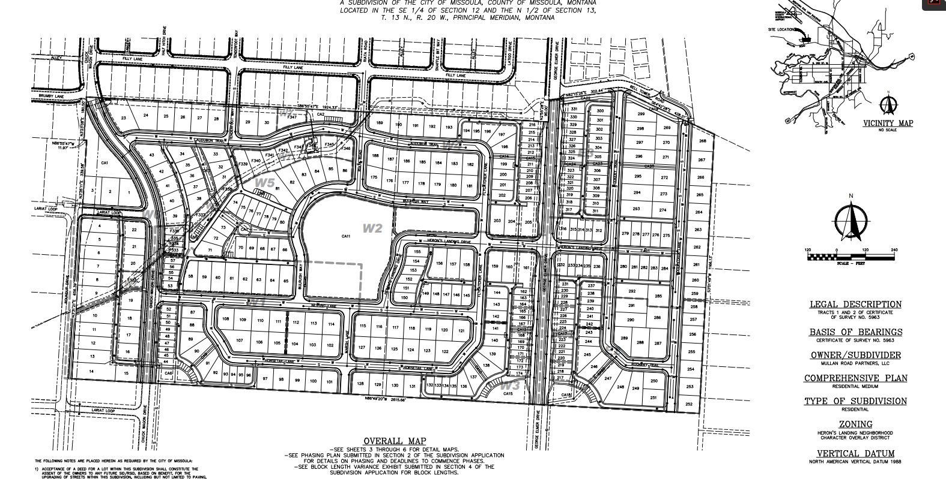
Planning Board Role in SUBDIVISION REVIEW
Process
Staff
1. Pre-application Meeting
2. Application
3. Element & Sufficiency
4. Site Inspection
5. Agency-Utility Review
6. Staff Report
7. Public Comment*
8. Board Recommendation*
9. Governing Body Action
10. Final Plat
Planning Board
Public
Planning Board Action Items*
City of Missoula - ci.missoula.mt.us/DocumentCenter/View/52380/21-preliminary-plat?bidId=
Notes:
Subdivision, generally speaking, is a division of land into parcels intended for sale or other transfer of ownership. The plat is the document that creates the land into subdivision lots. Subdivision plats include the overall layout of streets, utilities, lots, blocks and public areas. The schematic in the lower right hand corner of this slide is a subdivision plat for hundreds of lots.
The process of information from staff and the public to the planning board prior to their recommendation is the same general approach as for growth policies, as shown in the upper right hand corner of this slide.
There are 10 basic steps in subdivision review and only two require direct participation by the Planning Board. The two planning board activities are shown in gold on the slide.
The first 6 steps are generally managed by staff and include:
Staff hold a Pre-Application meeting with the subdivider to review initial concepts proposed by the subdivider and to review subdivision requirements
The Developer submits the Application
Staff Review the Application for all required elements and for the sufficiency of information
Site Inspection – this may include the planning board, but would need to be noticed as a planning board meeting
Staff submit the application to utility providers and local, state, and federal agencies to help determine if the subdivision meets other applicable regulations.
Staff report – this document includes findings of fact, conclusions, and staff recommendation on approval, conditional approval, or denial.
The next two steps involve the planning board.
7. Before the planning board makes its recommendation, it considers public comment. The Montana Subdivision and Platting Act requires at least one public hearing. Many communities have a hearing with the planning board and another with the governing body. Note that the first minor subdivision from a tract of record is exempted from any hearing requirement. A minor subdivision contains five or fewer lots.
The planning board makes its recommendation to the governing body to approve, approve with conditions, or deny the application.
9. The governing body considers the planning board recommendation along with public comment, subdivision application materials, and other information and makes their final decision. If the planning board has not held a public hearing, the governing body must hold one prior to its decision.
10. If the preliminary plat application is approved or approved with conditions, the subdivider then prepares materials for final plat. The governing body reviews those materials to ensure that conditions and final plat requirements have been met. Upon receiving final plat approval, the subdivider may file the plat with the clerk and recorder, and the lots are officially recognized as individual parcels for transfer.

Slide 9
SUBDIVISION REVIEW: Planning Board Recommendation
Approve
Approve with Conditions
Deny
Variances??
REVIEW CRITERIA
VARIANCES
608(3)(a)Criteria
Survey Requirements
Subdivision Regulation Requirements
Subdivision Review Procedures
Utility Easements
Legal and Physical Access
Relaxation of requirements
“Undue” hardship
Economic hardship alone is insufficient
Unique conditions on site
Cannot violate other regulations, increase public costs, adversely affect public health or safety
Form standards limit creativity and unique design
CONDITIONS
FINDINGS OF FACT
Subdivision does not meet review criteria or impacts are significant
…AND…
Conditions will bring subdivision into compliance and reduce impacts to acceptable levels
Foundation of the recommendation
Facts: Present facts for each criterion
Conclusions: for each criterion “Subdivision meets/does not meet criteria because [insert fact-based reason]
Notes:
The planning board recommendation is made based on review criteria, any requests made for variances, and conditions for mitigating adverse impacts. The rationale for the recommendation is made in the “Findings of Fact” and “Conclusions.”
The statutory review criteria are listed in the upper left hand corner. These include:
“608(3)(a) criteria - the subdivision review criteria for impacts on agriculture, agricultural water user facilities, local services, the natural environment, wildlife, wildlife habitat, and public health and safety
Survey requirements
Subdivision regulation requirements
Subdivision review procedures
Utility easements
Legal and physical access
If the subdivision does not meet review criteria or impacts are significant
…AND…
Conditions will bring the subdivision into compliance and reduce impacts to acceptable levels, then conditions can be part of an “approval with conditions.”
If a request for a variance has been received, the planning board recommendation must address the variances. A variance is a relaxation of a requirement when strict adherence would cause undue hardship. Economic hardship alone is insufficient to qualify as “undue hardship.” Typically, the undue hardship relates to unique conditions on the site. No variance can violate other regulations, increase public costs, or adversely affect public health or safety.
The importance of the “Findings of Fact” cannot be underestimated. They form the legal basis of the recommendation. Findings of Fact typically present facts for each review criterion and draw conclusions based on the facts.
The “Findings of Fact” and conclusions lead to the recommendation to approve, conditionally approve, or deny the subdivision.

Slide 10
PUBLIC INVOLVEMENT
Montana’s Open Meeting Laws
Public Comment
All government meetings open to the public
If there is a quorum, there is a meeting!
Provide reasonable notice (general rule – minimum of 2 days)
Information for every agenda item
Cannot add agenda items at the meeting
Provide opportunity for comment on each agenda item
Provide opportunity to comment on items not on the agenda
Provisions for people who cannot attend
Deadlines for comments
Contact Information
Listen carefully to oral comments
Read written comments
Responding to comment
Public Comment
samuii - stock.adobe.com
Notes:
Montana’s Open Meeting laws require all local government meetings, including planning board meetings, to be open to the public. Any time a quorum of members is present at a location, or in a car, or via phone or online meeting, could constitute a meeting subject to the open meeting requirements.
Basic Public Participation Requirements
Notice prior to the meeting – date, time, place, and agenda, plus information on how to submit comments separate from the meeting and a deadline for all comments. The notice must occur in a “reasonable period” before the meeting. A general rule of thumb for minimum notice is 48 hours, but be aware there are specific and longer noticing requirements for hearings.
Information – the public should have an opportunity to obtain information for every agenda item at the time notice is published (decision-makers and public should be on equal footing with respect to participation in the decision).
No new items can be added to the agenda at the meeting or hearing – carry over new items to the next regularly scheduled meeting or a special meeting.
Provide the opportunity for public comment on each agenda item.
The public must have the opportunity to comment on items that are not on the agenda.
Those who cannot attend or who need special accommodations must be given the opportunity to comment. Consider what may be needed for those with limited physical abilities – mobility, hearing, or sight.
For persons who cannot attend, provide information on how to submit comments and where to access meeting information. Issues associated with COVID-19, the pandemic that began in 2020, have highlighted the particular issue for persons who cannot attend meetings. Many communities have held in-person meetings with physical distancing, masking, rooms with good ventilation, or outdoor meetings. Others have opted for online meetings using Zoom or other software – and others have used both simultaneously.
The planning board does not need to respond to questions or comments individually; they need to listen to comments overall and then consider them in their entirety before making a decision.
Responding to each comment in a public meeting or hearing can result in a lengthier meeting, and possible back-and-forth dialogue with a handful of participants, potentially limiting others’ ability to discuss their concerns.

Slide 11
PLANNING BOARD MEETINGS
Regular Meetings
Special Meetings
Called by chair or request of any two board members
Noticing – at least 2 days, can be less under specific conditions
Held “Regularly”
Follow Bylaws
Noticing: If none identified in bylaws, follow “reasonable” notice per open meeting laws
Meetings/Hearings
General Info
Quorum: majority
No action official without a quorum
Follow open meeting law
How/Where to Notice
Access to materials to be discussed
Meeting Record
Robert’ Rules of Order or similar
Adjourn – or continue as a special meeting
Stella - stock.adobe.com
Notes:
There are two types of planning board meetings – regular and special. Both need to conform to open meeting laws.
Regular meetings are held “regularly” – Montana statute requires regular meetings to be held 4 times per year on specific months. Your bylaws should specify those times and you can add other times. Montana statute doesn’t have specific noticing requirements for regular meetings, so be sure and include standards for noticing meetings in the bylaws.
Montana statute allows special meetings to be called by the chair or at the request of any two board members. A minimum 2-day notice is required for special meetings, but can be waived if the special meeting is set at a regular meeting with all planning board members present. Before setting a special meeting without two-day notice, the planning board should consider if the matters to be discussed are of public interest and necessitate a longer notice period.
Whether it’s a meeting or hearing, the planning board cannot take official action without a quorum. The board must also comply with open meeting law requirements at the meeting, including opportunity for public comment, and access to the materials in advance of the meeting. Official actions should follow Robert’s Rule of Order or a similar standard for procedure.

Slide 12
PLANNING BOARD HEARINGS
Public Hearings -Noticing
Suggested Hearing Procedures
Subdivision Review Hearing
At least 15 days notice in newspaper of general circulation in county
Additional requirements as per your bylaws
Growth Policy Hearing
At least 10 days prior to hearing in newspaper of general circulation in county
Other Hearings
Follow noticing requirements in statute for the particular action
Agenda
Sign-in Sheet
Call-to-Order
Staff Report Presentation
Public Comment
Close Public Testimony
Board Questions
Deliberation and Action
Adjourn or Set Date and Time to Continue
Public Comment
Notes:
Noticing requirements is one of the main features that distinguish hearings from meetings. Statute sets out noticing requirements for a variety of public hearings for numerous types of actions, including adopting regulations.
For a hearing on a proposed subdivision, at least 15 days notice is required in a newspaper of general circulation. For a Growth Policy Hearing, it’s 10 days.
Growth Policy statute requires a community’s growth policy to identify the process for a subdivision hearing. Typical hearing procedures are shown on the right column and include:
Have copies of the agenda available
Have a sign-in sheet – for the meeting record
Call to order – The Chair calls the meeting to order, takes roll call, introduces the agenda and topics on the agenda, explains how the meeting will be conducted.
Staff Report Presentation – Staff presents the review of the application and staff report.
Public Comment – The planning board may start by requesting comment from the applicant and then comments from the public. Anyone who comments should state their name and address for the record. To reduce repetition and lengthy meetings, you can request that individuals limit their comments to 3-5 minutes, and that others do not repeat what others have said, but merely indicate support for something already stated. When all have had a chance to speak, you can ask those who have already spoken if they have more to say.
Close Public Testimony – Once all comment is completed, public testimony is closed.
Board Questions – At this point, the hearing is open for questions from the board to staff, the applicant or others.
Deliberation and Action – This is the point at which the planning board formulates their recommendation to the governing body.
Use Roberts Rules of Order or similar for planning board members to introduce a motion, discuss, revise the motion if needed, and vote.
9. Adjourn or Set a Date to Continue - If a hearing is continued, the date and time should be announced to those in attendance and posted as soon as possible for those not in attendance.

Slide 13
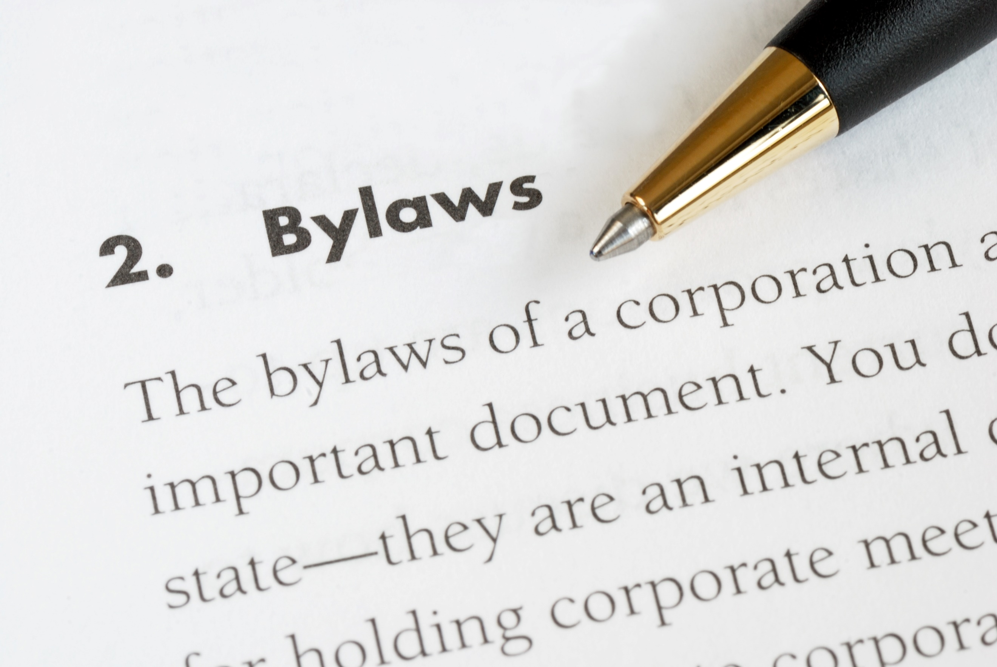
BYLAWS - Contents
Montana’s Open Meeting Laws
1. Authority - Purpose
4. Officers Duties
5. Meetings
2. Jurisdictional Area
3. Members
6. Ethics & Conduct
7. Committees
8. Admin & Legal
9. Staff
Public Comment
10. Amendment /Repeal
JohnKwan - stock.adobe.com
Notes:
Bylaws typically include the following information:
Authority, Purpose, Power, and Duties
This section includes a citation to state statute regarding the legal authority for creating the planning board as well as its purpose, powers, and duties.
Jurisdictional Area
Describes the jurisdictional area of the planning board – remember it can be any of the following:
City
County
City-county (often a city with a ring of county area around it) or
Other combinations of cities and county
Members and Terms
Describes number of members, qualifications, and length of terms. Bylaws should reflect or include state statutory requirements and can add other information, such as absences, vacancies, and removal of a board member.
Board Officers, Terms, and Duties
Montana statute requires officer election at the first regular meeting of each year. This section also typically addresses roles of the president and vice-president, officer vacancies, absences, removal of officers, and terms of office.
Meetings, Quorum, and Procedures
Provides detail for regular and special meetings, public hearings, what constitutes a quorum, noticing meetings, and procedures for board discussion and action (such as Robert’s Rules of Order).
Board Member Ethics and Conduct
Provides information on adhering to the principles of operating in the public interest, and avoiding conflict of interest and ex parte communication.
Committees
Provides information on how committees might be established to advise the planning board.
Administration and Legal
Addresses board recordkeeping, including meeting records. Also clarifies the board will seek legal advice from the city or county attorney for the planning board jurisdiction. This section may also address financial issues, such as reimbursement to planning board members for travel.
Staff
Discusses role of staff. Functions typically include role of secretary, preparing staff reports on subdivisions or other applications, financial management, drafting an annual report and annual budget to be reviewed and approved by planning board prior to submission to governing body.
Amendment and Repeal Provisions
Identifies procedures for amending bylaws and for repealing previous bylaws.

Slide 14
Planning Board MEMBER RESPONSIBILITIES
President/Chair
All Members
Presides over meetings
Calls special meetings
Signs official documents
Represents board in discussion with governing body
Ensures board actions are properly taken
Attend meetings
Be prepared for meetings
Be familiar with Bylaws
Be familiar with growth policies and regulations
Act ethically
Vice President/
Vice-Chair
Secretary/Staff
Keeps minutes
Prepares meeting/hearing notices and agendas
Keeps board records
Perform duties of President/Chair during President’s absence
Notes:
The President or Chair:
Presides over meetings
Calls special meetings
Signs official documents
Represents the board in discussion with governing body
Ensures board actions are properly taken
The Vice-President or Vice-Chair:
Performs duties of the President or Chair when that individual is not present
The Secretary is typically staff and
Keeps minutes
Prepares meeting/hearing notices and agendas
Keeps board records
All Members
Attend meetings - attend all meetings – if you can’t attend let the secretary know
Be prepared for meetings
Be familiar with Bylaws
Be familiar with growth policies and regulations
Act ethically

Slide 15
ETHICS AND CONDUCT
A conflict of interest – when a board member could obtain a private benefit
Either direct or indirect
Declare conflicts of interest
Conflicts of Interest
Gifts and Favors
Gifts, favor, or advantages to influence board member
When in doubt, decline the gift!
Influencing board members outside of public forum
Not presented to entire board at same time
Different information to different people
Not all sides have yet been heard
Ex Parte Communication
Notes:
A conflict of interest occurs when a board member could obtain some private benefit as the result of a planning board action. A private benefit may be either direct or indirect, such as creating a material personal gain or providing an advantage to relatives, neighbors, friends, or groups and associations to which the board member belongs.
Having a conflict of interest does not necessarily mean that you have done something wrong; it is normal for conflicts to arise from time to time. Not declaring a potential conflict of interest is wrong. It is illegal to fail to declare a substantial conflict of interest or to participate in discussion on issues or decisions where such conflict exists.
Gifts, favors, or advantages should not be accepted if they are offered to influence the board member or if it could appear to the public that the gift was offered for that purpose. Even minor considerations that come in the form of business lunches or small gifts are not acceptable. The best guide to follow regarding gifts and favors is this: If in doubt, decline the gift.
Ex Parte communication is a problem although it may not involve any gifts or other private benefit for the planning board member.
Ex parte is a Latin term that means, “from or on one side only.” It is related to the public interest because it deals with planning board members being influenced from outside the public forum without the benefit of hearing all sides of an issue.
Ex parte can include telephone calls, informal meetings, lunches, emails, or even a casual encounter on a street corner. The essential element of ex parte contact is that someone with a direct interest – an applicant, proponent, or an opponent of the project – is attempting to influence a planning board member.
How to Deal with Ex Parte Contact:
Stop the conversation when it veers to ex parte communication and invite the individual to present testimony before the entire planning board
If the person is unwilling to testify, encourage them to send a letter to planning staff so it is on the record
If you receive written information not sent to other planning board members, send it to planning staff to include in planning board packets
If you have ex parte contact, disclose that fact on the record before the meeting begins.

Slide 16
Planning Board Member - Best Practices
Prepare and maintain a growth policy
Develop and adopt bylaws and procedures and stick to them
Annually reexamine what you are doing and how well
Prepare an annual report
Consider a public forum every year or so
As a board, ask to participate in preparing the jurisdiction’s planning budget
Attend meetings with the governing body and planning board to exchange ideas and assess objectives
As a board, communicate with staff
Educate yourself on planning
Advocate for good planning
Notes:
We want to thank you for taking the time to listen to our presentation, and in closing, we will leave you with 10 best practices for all planning board members.
Prepare and maintain a growth policy, refer to it, make decisions that are consistent with its policies, and implement them
Develop and adopt bylaws and procedures and stick to them
Annually reexamine what you are doing as a planning board member, how well you are doing, and how to do better
Prepare an annual report that summarizes work of the past year and recommends priorities for the next year; submit the report to the governing body and share with the public
Consider a public forum every year or so – ask the public about how things are going and what they want to be done
As a board, ask to participate in preparing the jurisdiction’s planning budget
Attend meetings with the governing body and planning board to exchange ideas and assess objectives
As a board, communicate with staff what information you want that you may not be receiving, how you want materials presented to you, etc.
Educate yourself, attend courses on planning techniques or land use law
Advocate for good planning

Slide 17
RESOURCES
Montana Planning Board Member’s Handbook
Available on-line at the Community Development Division of the
Montana Department of Commerce website
Robert’s Rules of Order Online - http://www.rulesonline.com/
Planners Web: News and Information for Citizen Planners- http://plannersweb.com/
For More Information:
Community Development Division
of the
Montana Department of Commerce
P.O. Box 200501 Helena, MT 59620-0501
commerce.mt.gov
406.841.2700

