Slide 1
2022 wic Farmers market
FLATHEAD CITY-COUNTY HEALTH DEPT WIC OFFICE
Notes:
Thank you for taking the time to come back for vouchers and a short training.
Your WIC packet has information on market location and hours, list of local farmers who can accept vouchers, other counties participating in state

Slide 2
WHO’S ELIGIBLE FOR VOUCHERS?
Participants currently receiving WIC benefits except infants under 4 mo of age during season

Slide 3
CRITERIA FOR ELIGBILITY
Have to have a current and active certification (receiving WIC benefits)
CHILDREN 1-5 years old
INFANTS 4 months and older
PREGNANT WOMEN
POST PARTUM WOMEN
Breastfeeding (fully, substantially, partially)
Non-Breastfeeding
Who is eligible:

Slide 4
HOW MANY VOUCHERS CAN A FAMILY RECEIVE?
$30 per eligible person

Slide 5
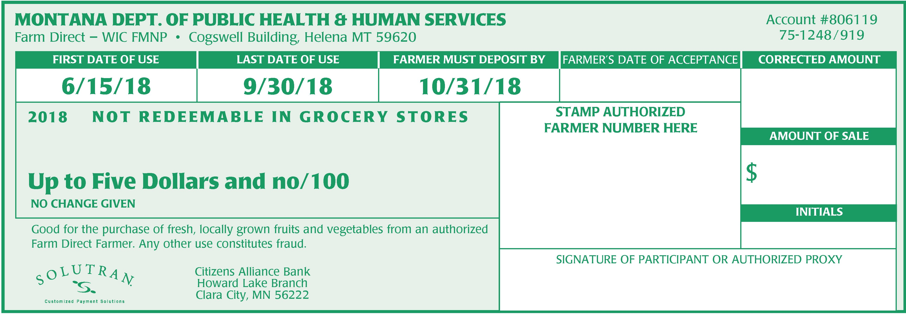
EXAMPLE:
1 pregnant + 2 CHILDREN + 4 MO. OLD
$30
$30
$30
$30
=$120 FOR THIS FAMILY
Notes:
(GO OVER EXAMPLE) “So if you’re pregnant, have 2 kids under 5 and a 9 mo old, your family would receive $120 worth of FM vouchrers.”

Slide 6
2022 FARMERS MARKET VOUCHERs
TIPS + REMINDERS
No signature required on voucher – this is a new change
No replacement vouchers can be re-issued
Not required to present ID
Last date to use vouchers is September 30, 2022
More than one voucher can be used in one shopping visit.
No change can be given if the full $5 amount is not used.
Any amount over $5 can be used with another voucher or be paid out-of-pocket.
No IOU’s, rain checks and refunds can be used
Purchase only WIC approved fruits and vegetables
Notes:
(READ ALL SHORTENED POINT – full points below)
· No replacement vouchers can be re-issued if lost, stolen or destroyed; treat these like cash.
· You do not need to provide identification (ID, WIC packet, card, booklet, etc).
· Use vouchers before Monday September 30, 2019 (Saturday September 28th in Kalispell would be the last market to use them at).
· More than one voucher can be used in one shopping visit.
· No change can be given if the full $5 amount is not used.
· Any amount over $5 can be used with another voucher or be paid out-of-pocket.
· Sign the benefit before you leave.
· No IOU’s, rain checks and refunds if forgot or lost vouchers while shopping.
· Buy only WIC approved fruits and vegetables (use the “Farm Eligible Food List” attached as a guide)
Redemption or use of vouchers was low last year, so please try to use all of your vouchers so WIC can continue this amazing program.
Due to the limited amount of vouchers, if you are unable to use any vouchers, please return them to the clinic here or CFalls so we can give to another family after we run out of vouchers.

Slide 7
WHERE CAN YOU USE VOUCHERS AT?
Farmer Markets

Slide 8
2022 Farmers market locations
MONDAY
Bigfork Village Market – 191 Mill Street, Bigfork– 5:00 -7:30 PM (June-Sept)
NO market on Labor day
TUESDAY
Whitefish Market – Central Avenue at Depot Park (by library and train station, Whitefish –
5:00-7:30 PM (May-Sept)
WEDNESDAY
Bigfork Farmers Market – Next to the Bigfork Liquor Barn, Bigfork – 3:00-6:00 PM (May-Sept)
THURSDAY
Columbia Falls Market – The Coop 830 1st Ave W, Columbia Falls – 5:00-9:00 PM (May-Sept)
SATURDAY
Flathead Valley Community College – South Parking Lot, Kalispell, 9:00-12:30 PM (May-Oct)

Slide 9
HOW DO YOU KNOW IF THEY’RE WIC APPROVED?
You will see a sign

Slide 10
2022 FARMERS MARKET poster
LOOK FOR THIS POSTER
Any WIC authorized farmer in the state of Montana with this sign can accept your vouchers!
Notes:
Some WIC farmers may not have a banner with their name, so to know if they can accept WIC vouchers, LOOK FOR THIS POSTER (point)
Again, if you see other farmers not listed on your paper and they have this poster, you can shop at their stand.
Any farmer in the state with this poster is WIC approved and can accept your vouchers!

Slide 11
2022 FARMERS MARKET IN OTHER COUNTIES
https://dphhs.mt.gov/Portals/85/publichealth/documents/WIC/Retailers/Farm%20Direct/FY19FarmDirectListofFarmers.pdf
COUNTY | CITY
Carbon | Bridger, Joliet
Cascade | Belt, Great Falls
Gallatin | Bozeman, Willow Creek, Three Forks, Belgrade, Manhattan
Golden Valley | Ryegate
Lake | Arlee, St. Ignatius, Dayton, Big Arm
Lewis and Clark | Helena, Wolf Creek
Meagher | White Sulfphur Springs
Missoula | Missoula, Frenchtown, Huson
Park | Emigrant, Livingston, Wilsall, Clark
Pondera | Ledger, Conrad, Valier
Ravalli | Hamilton, Stevensville, Florence, Victor, Corvallis, Darby, Pinesdale, Bonner
Richland | Savage
Sanders | Dixon, Paradise
Stillwater | Columbus, Park City
Teton | Pendroy, Choteau
Wheatland | Harlowton
Yellowstone | Billings, Laurel, Broadview, Shepherd
Notes:
So if you’re busy camping or traveling to or through these area through the end of September, you can use your vouchers if they have farmers market; again just look for the WIC poster.
Here is a list counties in the state that have their own farmers market or WIC approved farmers.

Slide 12
What can my vouchers be used for?
FRUITS AND VEGETABLES ONLY

Slide 13
2022 approved fruits and vegetables
Approved fruits & vegetables
NON-APPROVED ITEMS
Notes:
Fruits and vegetables are only approved, items like: baked goods, cheese, crafts, eggs, honey, juice, nuts and plants (herb or vegetable) are not approved.
You will receive a copy of this list and a farmer will have it posted on their stand as well.

Slide 14
2022 fruits & vegetables in season
Lots of foods in Summer in Fall
Visit market as soon as opens, not close to ending/closing
No luck first visit? Try again!
Notes:
The Missoula Community Food & Agriculture Coalition created a handout of many foods grown or raised in MT.
We cross referenced their list with the WIC approved produce and created this handout that lists both season and WIC approved produce in season, those foods are colored and underlined with a star on this handout you’ll receive.
As you can see, not a ton of produce in June that is why we waited to issue benefits in July.
If you visit a market once and don’t have luck with produce, do not be discouraged, try another time or check out another market.
It’s best to visit the markets as soon as they open whichever day instead of visiting close to ending/closing when less produce could be already sold or unavailable.

Slide 15
SNAP DOLLARS PROGRAM
Receive a dollar-for-dollar match to spend on fruits and veggies at the Columbia Falls, Kalispell and Whitefish Farmers Markets – ask about maximum match amount.
Eligible for up to $20 per market, every week throughout the summer!
Notes:
Quick tidbit on using SNAP (or Food Stamps) at farmers market if you’re on it.
If you’re not on SNAP and want to apply, brochures with the link to apply online are on the table.

Slide 16
QUESTIONS?
Please text 406-890-3231 or 406-890-3056

Slide 17
THANK YOU and enjoy!
HAVE A GREAT SUMMER!
Notes:
Help yourself to some info on adding more fruits or vegetables in your day and one on fruit/veggie recipe.
(if still available) Sprout magazine has some amazing bits on: snacks, herbs and spices, make your own applesauce, salad dressing, pasta sauces and garlic bread, mix & match smoothies, vegetable minestrone, any veggie frittata and growing your own garlic indoors!

